Slide 1




BLOOD GROUP DETECTION BASED ON FINGERPRINT
Presented by:
Samyuktha Rama
Sabbidi Snehalatha
Racharla Vishwas

Slide 2
Contents
Introduction
Problem Statement
Methodology
i. Data Collection
ii. Preprocessing
iii. Model Architecture
iv. Model Training
v. Validation
Results
Conclusion

Slide 3
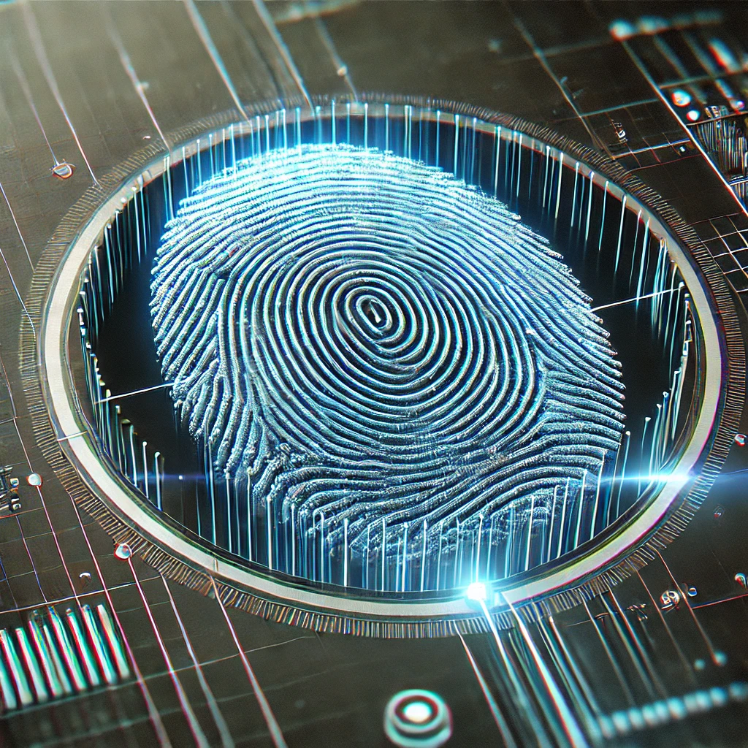
Introduction
Overview: Blood group identification is essential in medical and forensic fields, but traditional methods can be slow and invasive. Recent research explores fingerprint analysis as a non-invasive, faster alternative.
Objective: This project aims to investigate whether fingerprint patterns can be linked to blood group types, offering a quicker and more accessible method for blood group detection.
Significance: Detecting blood groups via fingerprints could enhance emergency medicine, forensic investigations, and situations where rapid blood type identification is critical.

Slide 4
Problem Statement
Current Challenges | Need | Potential
Traditional methods of blood group testing are time-consuming, invasive, and require specialized equipment and trained personnel. In emergency situations, there may be insufficient time to perform blood tests, and quick access to blood type information is essential. | There is a demand for a faster, non-invasive method to determine blood group, especially in critical environments such as hospitals, accident scenes, and disaster relief efforts. | Fingerprints are unique to individuals, and their patterns could potentially hold correlations to a person’s blood group. If a reliable link between fingerprints and blood group can be established, it could enable faster identification in various emergency and forensic scenarios.

Slide 5
Methodology
Data Collection: Collect fingerprint samples and their corresponding blood group information.
Preprocessing: Clean and standardize the fingerprint images for accurate analysis.
Feature Extraction: Extract key features such as minutiae points and ridge patterns from fingerprints
Model Building: Develop a CNN model to correlate fingerprint features with blood groups.
Model Training : : Train the model with the model design.
Validation : Validate the model accuracy.
Testing and Evaluation: Assess the model’s performance in real-world scenarios to ensure its effectiveness.

Slide 6
Data Collection:
The dataset consists of fingerprint images labeled by blood groups. Images are organized into folders named after each blood group.
Preprocessing:
Grayscale Conversion: Images are loaded in grayscale using OpenCV.
Image Resizing: Uniform resizing to nxn pixels.
Normalization: Pixel values are normalized.
Label Encoding: Blood group labels are mapped to integers.
One-Hot Encoding: Labels are converted into one-hot encoded vectors.
Data Split: Training (80%) and Testing (20%) dataset split.
Goal: Prepare the dataset for efficient CNN model training.

Slide 7
Model Building:
The model uses a Convolutional Neural Network (CNN) to classify blood groups from fingerprint images.
The model architecture includes multiple layers:
i. Conv2D layers (32, 64, and 128 filters) with ReLU activation for feature extraction.
ii. MaxPooling2D layers (2x2) to reduce spatial dimensions.
iii. Flatten layer to convert 2D features into 1D.
iv. A Dense layer (128 units) to integrate features.
v. A Dropout layer (0.5) to prevent overfitting.
vi. A final Dense layer (8 units, softmax) to output probabilities for blood groups.

Slide 8
Model Training:
The model is compiled with the Adam optimizer, categorical cross-entropy loss, and accuracy as the evaluation metric.
It is trained for 10 epochs with a batch size of 32, using 80% of the data for training and 20% for validation.
The trained model is saved for future use.
Validation includes preprocessing steps such as grayscale conversion, Gaussian blur, and Canny edge detection to ensure the image is a valid fingerprint before classification.
Validation:
Grayscale Conversion: Converts images to grayscale to highlight ridge details.
Noise Reduction: Applies Gaussian blur to remove noise.
Edge Detection: Uses Canny edge detection to identify ridge patterns.
Edge Pixel Percentage: Sets a threshold of 5-20% edge pixels to ensure sufficient ridge structure.

Slide 9
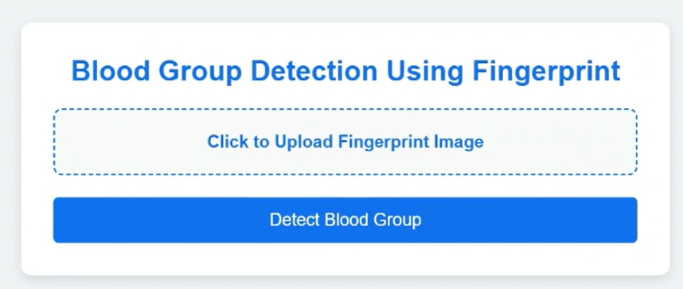
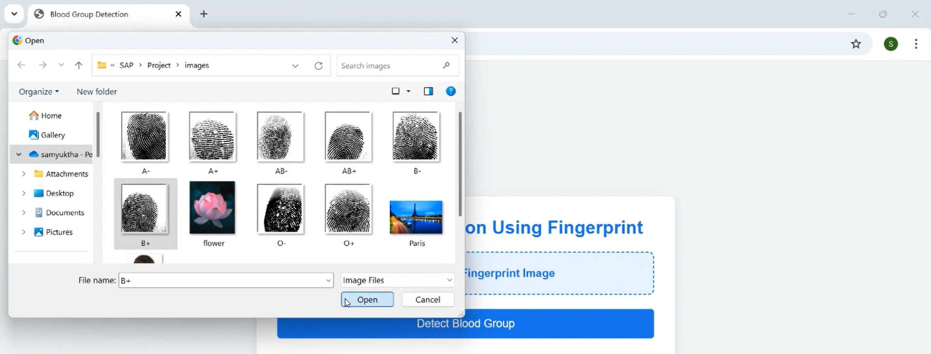
Results
Interface Design
Uploading image to know blood group

Slide 10
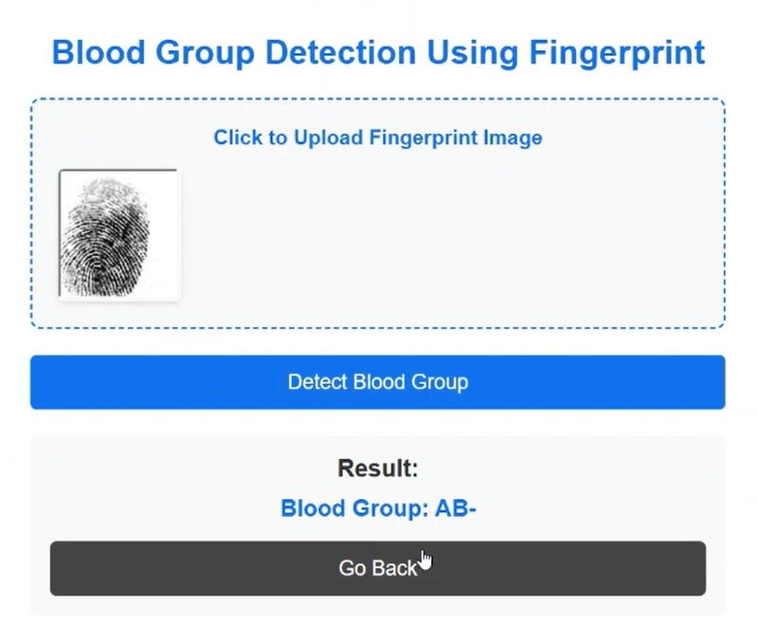
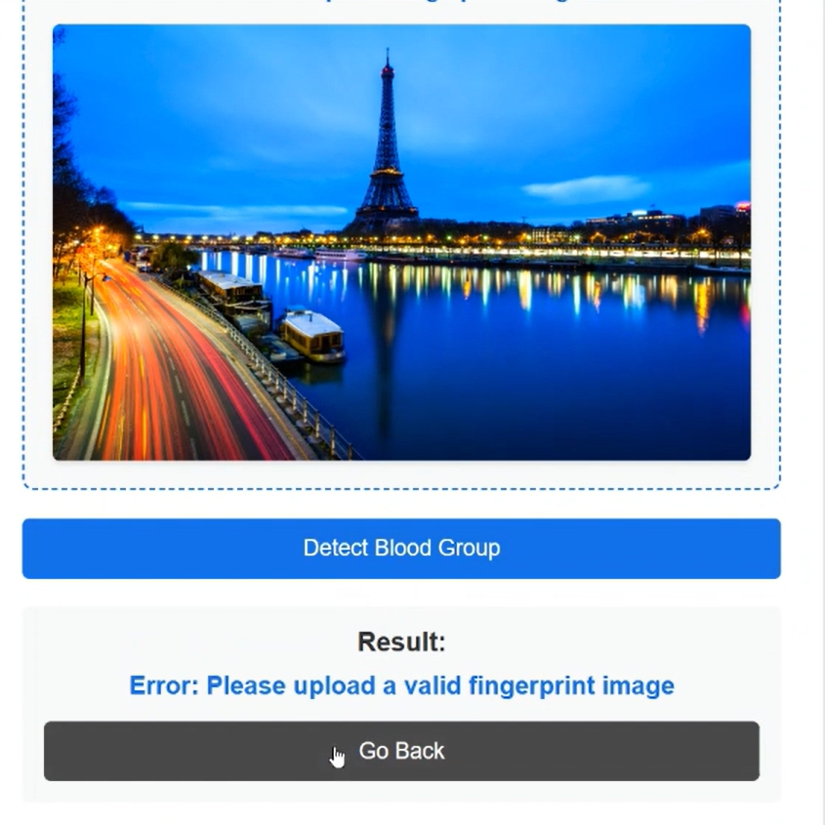
Checking image is a fingerprint or not and giving prediction
Case1:
For a Finger print image giving prediction
Case2:
For a Non-Fingerprint image throws error

Slide 11
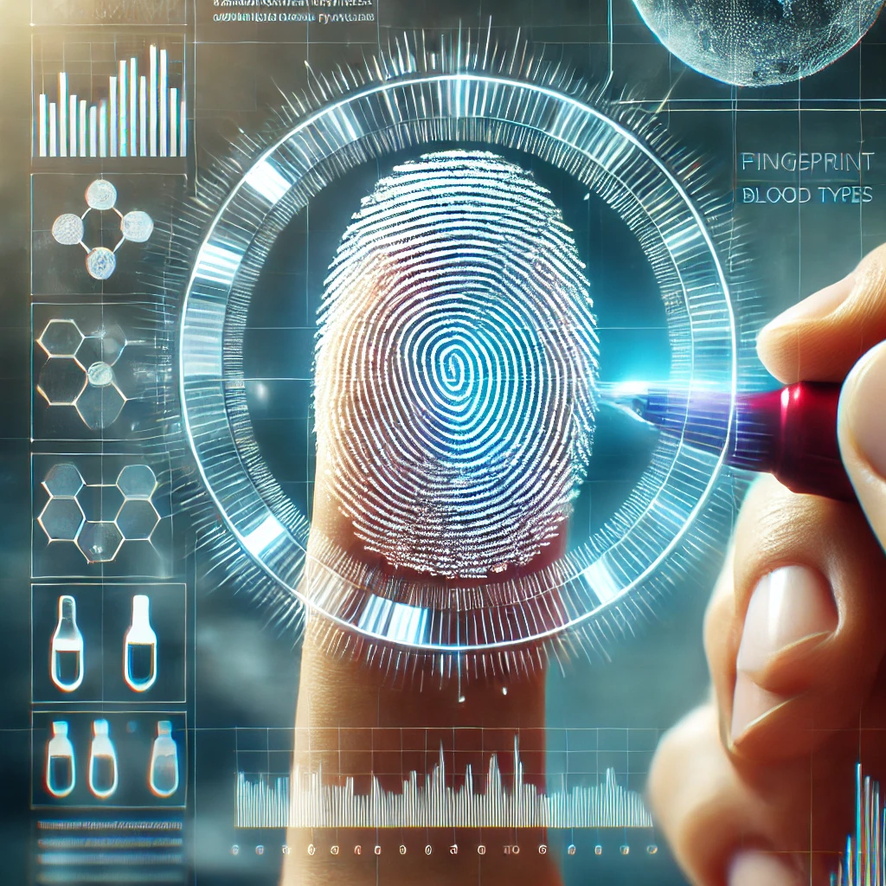
Conclusion
The system provides a non-invasive, faster alternative to traditional blood group detection using fingerprints and CNNs.
It can improve emergency medical care by enabling quick blood type identification.
Beyond healthcare, the technology has potential in secure identity verification and low resource settings.
Advancements in deep learning will enhance the system's accuracy and efficiency over time.

Slide 12
Thank you...!
Notes:
12

